Slide 1
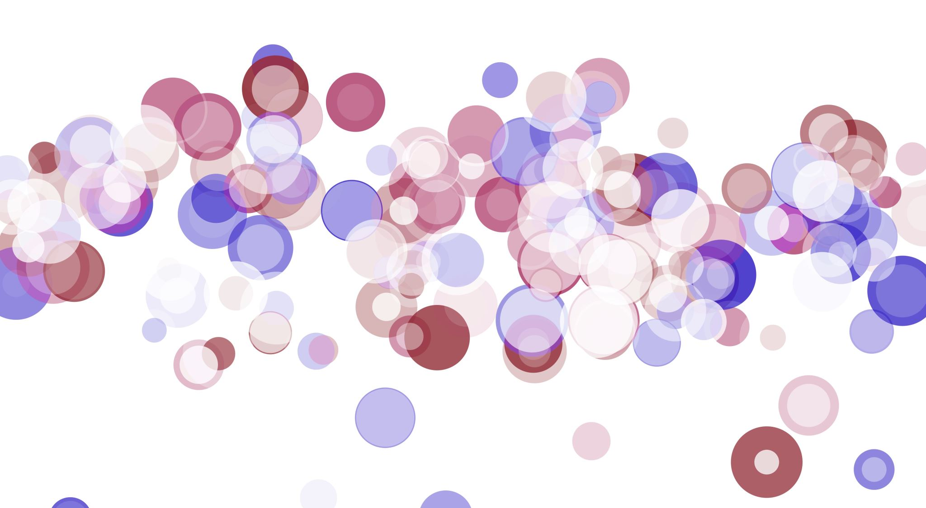
COMMUNICABLE DISEASES

Slide 2
COMMUNICABLE DISEASES
Communicable (infectious) diseases are caused by organisms that enter the body so that they can reproduce.
Disease causing organisms are called pathogens.
Some pathogens are contagious. They can be passed on by direct contact with the sufferer or by touching something that was touched by them.
Some pathogens are spread by vectors, Vectors are an intermediate host (e.g. mosquito/ flea) through which the disease is spread.

Slide 3
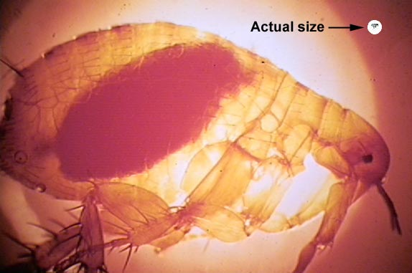
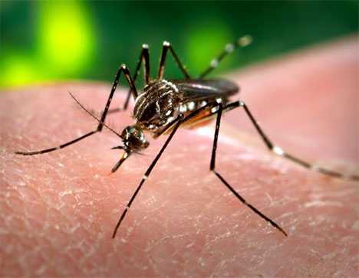
EXAMPLES OF VECTORS
Vectors -organisms that carry the disease from one person to the next e.g. Mosquito, fleas, rats.
Examples of diseases carried by vectors;
Malaria, Ross River Virus ,Rabies,
Bubonic Plague
Notes:
Bubonic plague is the best known manifestation of the bacterial disease plague, caused by the Gram-negative bacterium Yersinia pestis (formerly known as Pasteurella pestis). It belongs to the family Enterobacteriaceae. The term "bubonic plague" was often used synonymously for plague, but it does in fact refer specifically to an infection that enters through the skin and travels through the lymphatics, as is often seen in flea-borne infections. Bubonic plague kills about half of infected patients in 3–7 days without treatment, and is believed by many to be the Black Death that swept through Europe in the 1340s, killing tens of millions.^{[1]}
The bubonic plague is an infection of the lymphatic system, usually resulting from the bite of an infected flea, Xenopsylla cheopis (the rat flea). The fleas are often found on rodents, such as rats and mice, and seek out other prey when their rodent hosts die. The bacteria form aggregates in the gut of infected fleas and this results in the flea regurgitating ingested blood, which is now infected, into the bite site of a rodent or human host. Once established, bacteria rapidly spread to the lymph nodes and multiply.

Slide 4
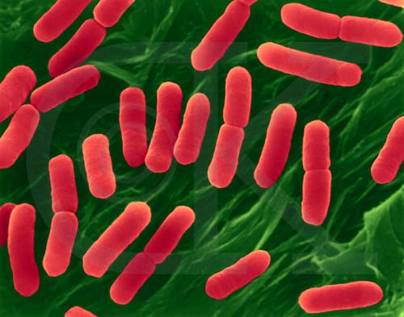
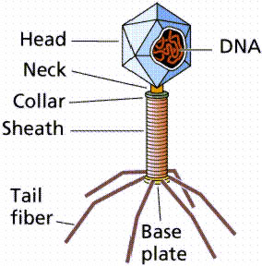
TYPES OF PATHOGENS
1. Bacteria (e.g. syphilis)
2. Viruses (e.g. HIV)

Slide 5
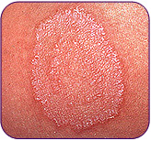
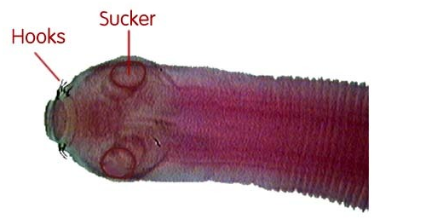
TYPES OF PATHOGENS
3. Fungi (e.g.Tinea)
4. Animal parasites (e.g Lice, worms)

Slide 6
FEATURES OF BACTERIA
Unicellular organisms- many of which are non-pathogenic.
They can be seen with a microscope.
Classified according to shape. For example, cocci are spherical, spirochaetes are coiled.
They have a rigid cell wall (like plant cells) but have no true nucleus even though D.N.A is present.
Can form spores to survive in adverse conditions.

Slide 7
BACTERIA Cont....
Many bacteria are helpful such as the bacteria found in the alimentary canal.

Slide 8
FEATURES OF VIRUSES
Viruses are much smaller than bacteria. They can only be viewed with electron microscopes.
They can only grow/ multiply in living cells.
They have a DNA or RNA molecule structure that contains genetic material. This is surrounded by a protein coat.
The DNA or RNA causes the host cell to make more virus particles so that new particles can exit the cell & infect other cells.

Slide 9
VIRUSES Cont...
Bacteriophages are viruses that infect/ multiply inside a bacterium ultimately killing it and breaking out into many virus particles.
Some viruses aren't pathogenic.
The genetic material of viruses & bacteria can be useful because vaccines/ treatments can be created out of it.

Slide 10
FUNGI
Most fungi aren't pathogenic.
The fungi that cause disease in humans often effect the epidermis layer of the skin (e.g. tinea).

Slide 11
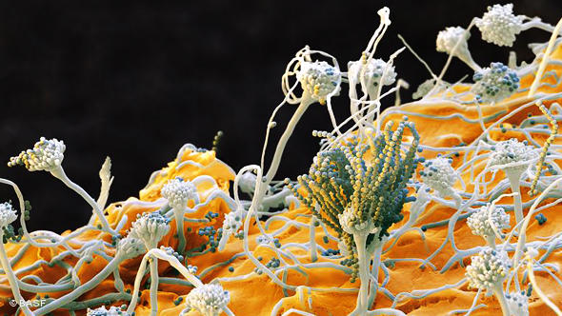
FUNGI
Examples: Athletes Foot, ringworm, thrush
Notes:
Spores pictured here

Slide 12
ANIMAL PARASITES
Parasite- any living organism that lives on or in another organism.
Host- Organism that is preyed on by the parasite
Ectoparasites- parasites living externally (e.g. fleas on skin).
Endoparasites- parasites that live within the body (e.g roundworms).

Slide 13
DEFENCES AGAINST PATHOGENS
The body defends against pathogens often by killing them before the symptoms of the disease become evident.
It has non-specific & specific defence mechanisms.
Non- specific defences provide protection against all pathogens while specific defence mechanisms are geared to deal with one type of pathogen.

Slide 14
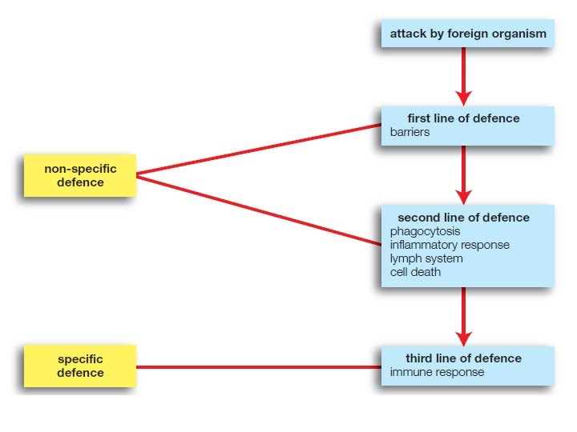

Slide 15
MODES OF TRANSMISSION
Contact –spread through direct (touching an infected person) or indirect (touch object that has been touched by infected person) physical contact eg Skin infections and STI’s
Body fluids - transfer of pathogen when blood or other body fluids comes into contact with mucous membranes or blood of uninfected person eg HIV, Hep B and through break in skin or shared needles
Infection by droplets – inhale droplets of moisture, harbouring pathogenic organisms that were emitted by sneezing, coughing, talking eg Influenza, measles, mumps, colds are spread this way.
Ingestion – transfer by food or drink contaminated with pathogens. Dysentery, Salmonella food poisoning
Airborne transmission – exhaled droplets evaporate into air, many bacteria are killed BUT some pathogens remain alive and can cause infection when inhaled eg Tuberculosis, Whooping cough and Diptheria.
Vectors – transfer by other animals, such as insects, ticks or mites eg. malaria and dengue are spread by female mosquitoes.

Slide 16
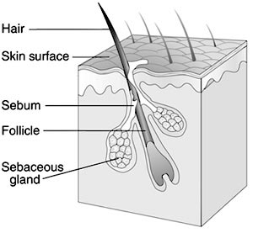
THE EXTERNAL DEFENCE SYSTEM
SKIN -an impervious layer that has sebaceous glands which produce an oily substance called sebum.
Sebum has antibacterial properties
Notes:
Insert Pic – Dust (dust = most dead skin)

Slide 17
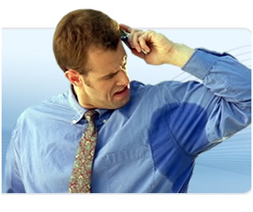
THE EXTERNAL DEFENCE SYSTEM
SKIN
The skin has sweat glands which produce sweat which also has antibacterial properties (lysozyme in the sweat)
The skin is also slightly acidic which makes the skin unsuitable for many pathogens
Notes:
Insert Pic – Sweaty armpits

Slide 18
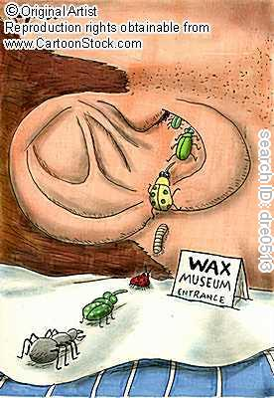
THE EXTERNAL DEFENCE SYSTEM
EAR
Secretes a substance called Cerumen (ear wax) which can protect the outer ear from bacterial infection and also repels insects.

Slide 19
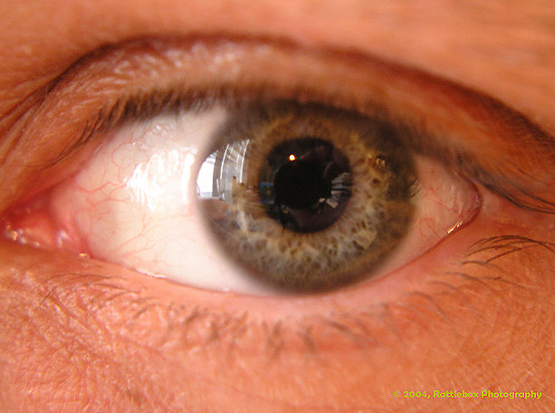
THE EXTERNAL DEFENCE SYSTEM
EYES
The tear ducts produce tears which contain the antibacterial enzyme lysozyme (same enzyme in sweat and saliva).

Slide 20
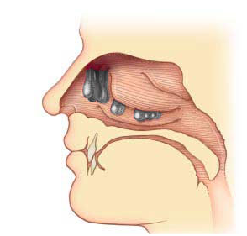
THE EXTERNAL DEFENCE SYSTEM
NASAL CAVITY
The Nasal Cavity is lined with CILIA which trap dust, small insects, and other micro-organisms which may cause disease.
Mucus traps air borne pathogens which can be swept out of the cavity using fine hairs.

Slide 21
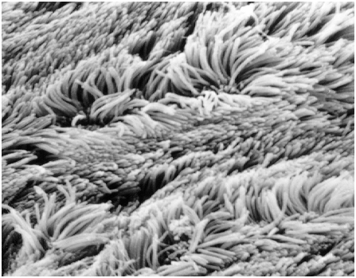
THE EXTERNAL DEFENCE SYSTEM
TRACHEA (RESPIRATORY TRACT)
The trachea and bronchi
are lined with cilia and mucus to trap and sweep out potentially harmful micro-organisms.

Slide 22
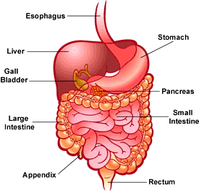
THE EXTERNAL DEFENCE SYSTEM
STOMACH
The stomach secretes hydrochloric acid during digestion. The acid kills many bacteria and other potentially harmful microorganisms.

Slide 23
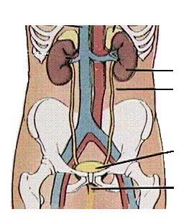
THE EXTERNAL DEFENCE SYSTEM
URETHRA
The regular flow of urine through the urethra has a cleansing action and prevents bacterial infection.

Slide 24
EXTERNAL DEFENCE
VAGINA- Contains acids which kill micro-organisms.
ANUS- Contains mucus that traps micro-organisms

Slide 25
PROTECTIVE REFLEXES
Sneezing- Forces the expulsion of noxious gas or micro-organisms out of the mouth or nose.
Coughing- Expels foreign matter from the lungs.
Vomiting- a means through which the stomach can get rid of foreign substances.
Diarrhoea- a means through which the body can quickly get rid of protozoa, bacteria or viruses from the alimentary canal.

Slide 26
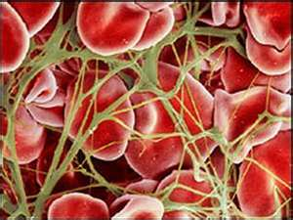
BLOOD CLOTTING- minor damage
1. Muscles in the walls of damaged blood vessels constrict to reduce blood flow.
2. Damaged walls are roughened allowing thrombocytes to stick to the walls.
3. Stuck thrombocytes attract more and then form a plug

Slide 27
Minor damage cont…
4. This plug reduces blood loss.
5. The thrombocytes secrete substances that act as vasoconstrictors to further reduce blood loss.

Slide 28
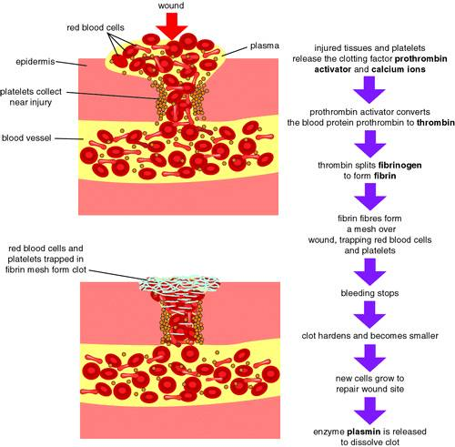
BLOOD CLOTTING- major
1. The clotting factor protein in the blood called PROTHROMBIN becomes converted to THROMBIN.
2. Thrombin converts FIBRINOGEN into FIBRIN.
3. Fibrin forms a mesh that traps erythrocytes, plasma and thrombocytes (see figure 9.4 of text).

Slide 29
CLOTTING- major cont…
4. The fibrin mesh with its trapped particles is now called a clot.
5. Once the clot is formed, clot retraction takes place. Clot retraction is where the fibrin threads become thicker and pull the edges of the damaged blood vessels together.
6. Serum fluid is squeezed out of the clot during clot retraction (also known as pus).
7. The clot then hardens into a scab.

Slide 30
INTERNAL NON-SPECIFIC DEFENCES
Phagocytes are cells that engulf (phagocytosis) foreign or damaged particles to neutralise the effect that they may have on the body.
Leucocytes are white blood cells that can move from the blood -stream into the tissue where a bacteria or injured tissue may be. They can secrete substances that destroy bacteria before phagocytosis occurs.
Macrophages are large cells that can engulf or kill pathogens (see figure 9.6 of text)

Slide 31
INFLAMMATORY RESPONSE
INFLAMMATION occurs when there is damage to tissue.
The inflammatory response is necessary to;
1. Reduce the spread of a pathogen, destroy pathogens and prevent the entry of more pathogens.
2. Remove damaged tissue and cell debris
3. Repair damaged tissue
There are four inflammation signs. They are- pain, swelling, redness & heat.

Slide 32
INFLAMMATORY RESPONSE STEPS
Step 1- MAST CELLS located in damaged tissue secrete HEPARIN and HISTAMINE.
Step 2- Histamine increases the blood flow to the area and makes the nearby blood vessels more leaky to fluid.
Step 3- Heparin prevents the nearby area from clotting but does form a barrier around the perimeter of the damaged tissue so that any pathogens cannot escape.
Step 4- The release of these chemicals attracts phagocytes to the area.

Slide 33
INFLAMMATORY RESPONSE Cont..
Step 5- Pain receptors in the area are stimulated.
Step 6- The phagocytes that are filled with bacteria and cell debris die and form pus.
Step 7- Mitosis makes new cells for the area and damaged tissue becomes repaired.

Slide 34
THE LYMPHATIC SYSTEM- A NON-SPECIFIC DEFENSE
The parts of the lymphatic system include:-
1. Lymph vessels & capillaries
2. Lymph nodes/ glands
3. Lymph organs such as the thymus
The lymphatic system functions to protect against pathogens & return excess fluid that has left the blood plasma back into the circulatory system.

Slide 35
LYMPH
Is any fluid found within the lymph capillaries/ vessels that is ultimately returned to the blood.
Fluid (plasma) that has been drained out of the blood into the interstitial space at the arteriole end of the blood capillary (due to the high blood pressure in arteries) will either re-enter the blood at the venule end of the capillary or pass into the lymph capillaries located between the cells.
Lymph travels from the tissue (in a one way direction) & re-enters blood at the subclavian vein.

Slide 36
Lymph Vessels
Have lymph nodes periodically located along them.
Have valves (like veins) to prevent back flow.
Are larger & more permeable than blood capillaries.Note: This makes it easier for large pathogens to pass into the lymphatic system.
Are easily squeezed by skeletal muscle which helps to move the lymph through the lymph capillaries.

Slide 37
Lymph Nodes
Many lymph nodes are found around the groin, armpit, neck & alimentary canal areas.
They are bean-shaped with many fibres that form a net to catch debris and/or pathogens.
Located within the nodes are white blood cells called macrophages that ingest foreign particles by phagocytosis thus providing a non-specific defence.

